Slide 1

Data Mining Project on Bankruptcy
Team: Data Saiyans

Slide 2
Focus Areas
1
Class Imbalance
2
Reduce randomness
The bankrupt companies were a minority class(2.11%) in the original dataset.
Try different methods of oversampling
reduce overfitting from oversampling to reflect actual distribution
Try different models with different parameters
Use ensemble to average the results to reduce bias and randomness
20
80

Slide 3
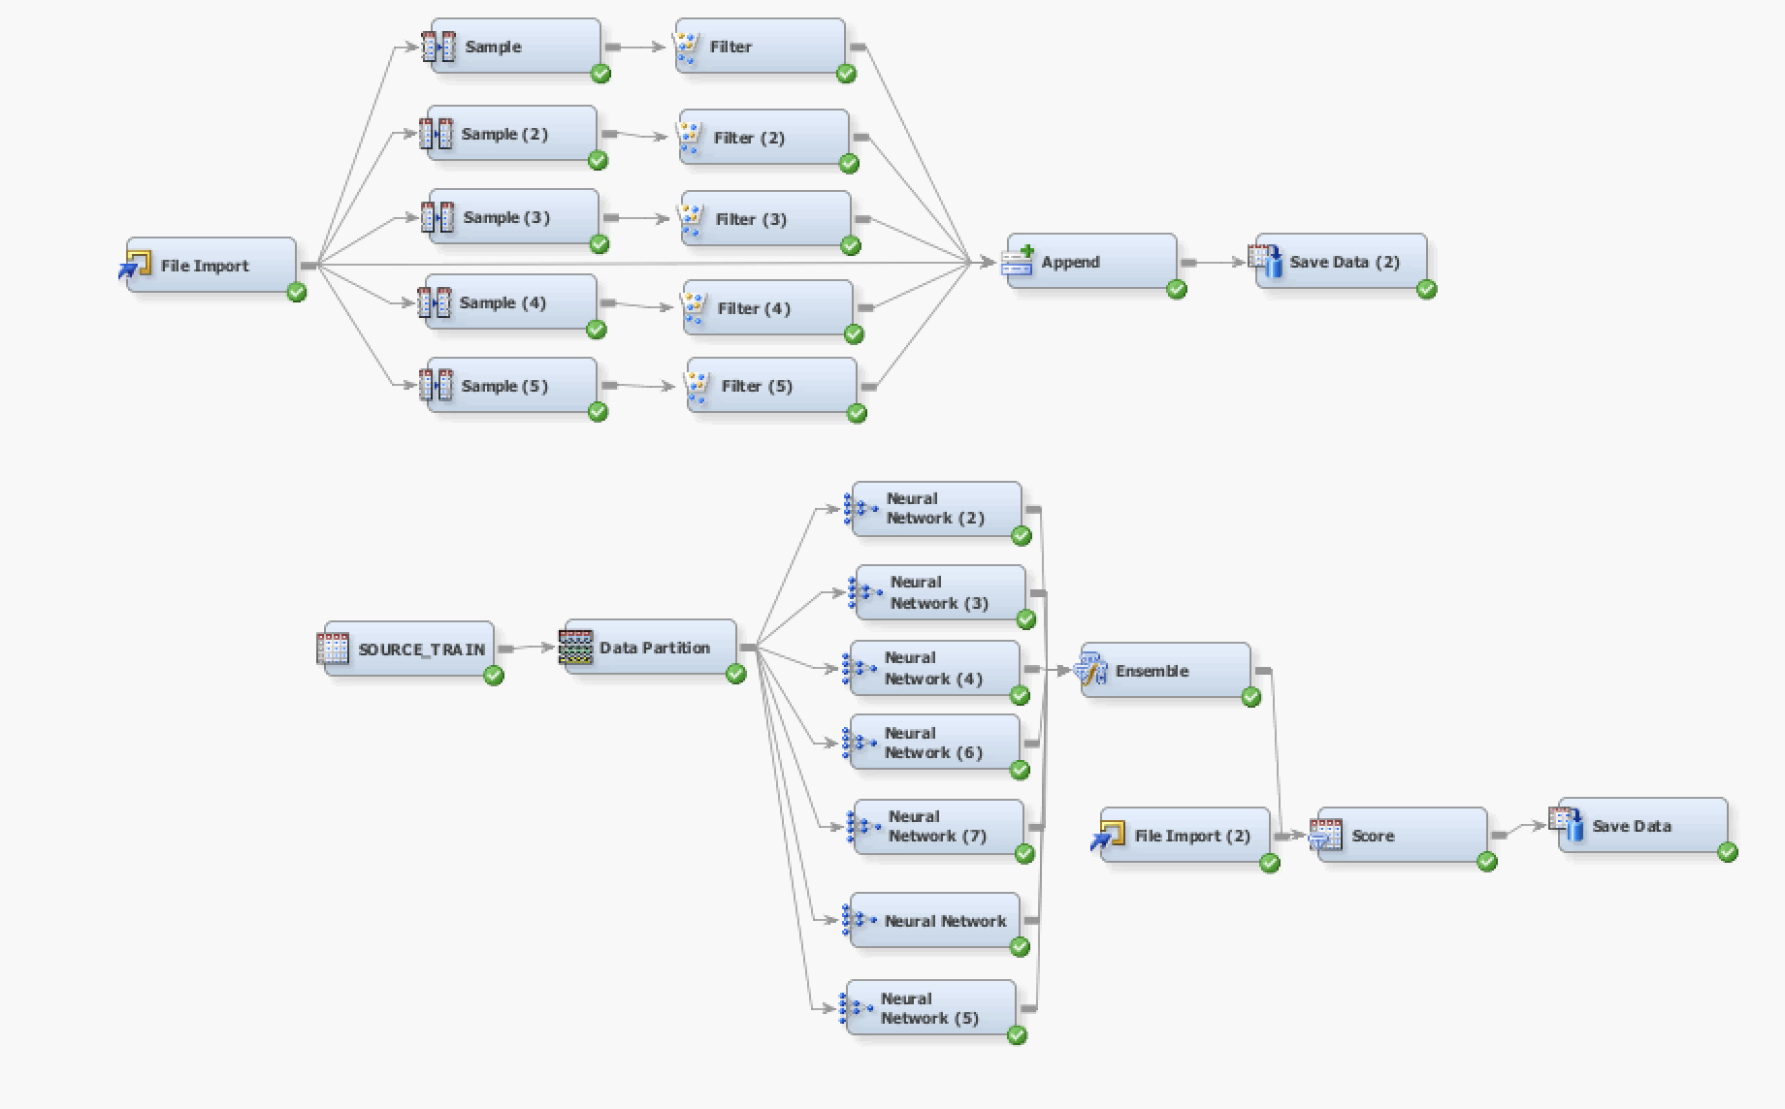
Finalized Algorithm
Data preprocessing:
Filter minority class data 5 times and add it back to the original dataset
Dataset was then imported using input data node and prior probability was set
Model:
Multiple neural network nodes with different iterations (50,100 and 150) and initiation seeds to reduce the effect of randomness.
All models’ selection criteria was set to misclassification rate
Introduce prior probability to the modified dataset to reduce bias and overfitting
Data Partition was set to 70:30

Slide 4
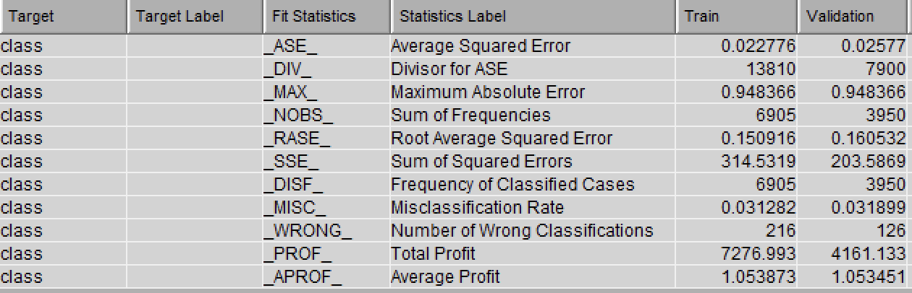
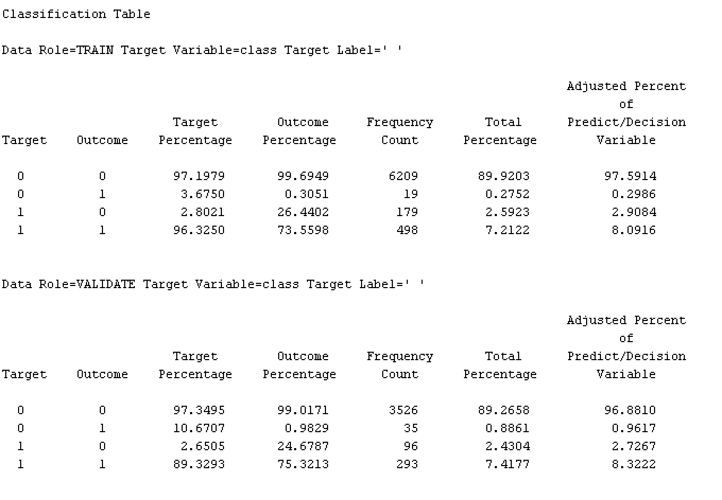
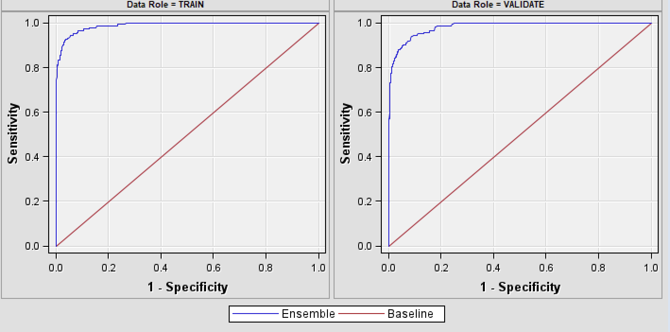
Results

Slide 5
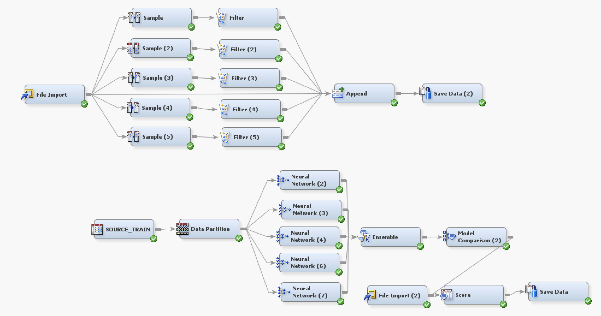
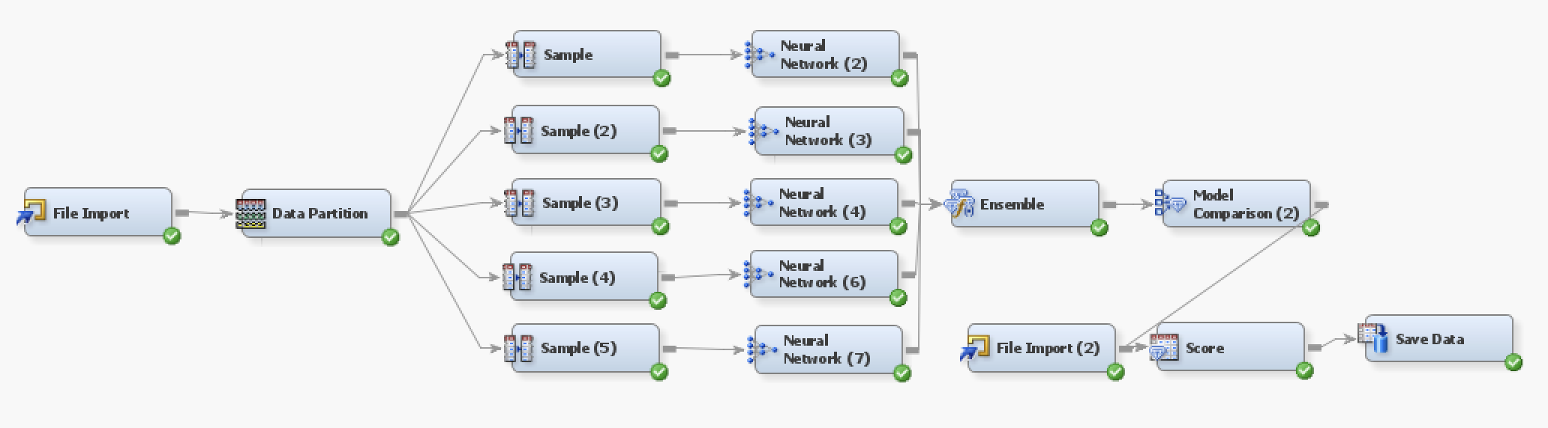
Other Algorithms
Model 1:
Similar algorithm to final one but with a smaller number of neural network nodes
Model 2:
Smaller samples each connected a neural network node with 10% minority class
Model was overfitting and highly volatile
Tried different models- Neural networks, decision trees (HP tree and gradient boosted) and logistic regression –Finalized neural networks for final model building

Slide 6
Learnings
Handling highly imbalanced dataset
Tuning parameters of different models to achieve optimal setting- trial and error!
Randomness plays a huge role
Could’ve tuned the models better and build a more robust model to handle different scenarios
Could’ve simplified the model complexity – reduced variables and used lesser number of model nodes

